Slide 1
Who are we?
The DS Board
The Doctoral Student Guild (DS) is a Student Union (SU) body at Chalmers University of Technology (Chalmers).
DS exists to evaluate and solve issues that are of joint interest to doctoral students.

Slide 2
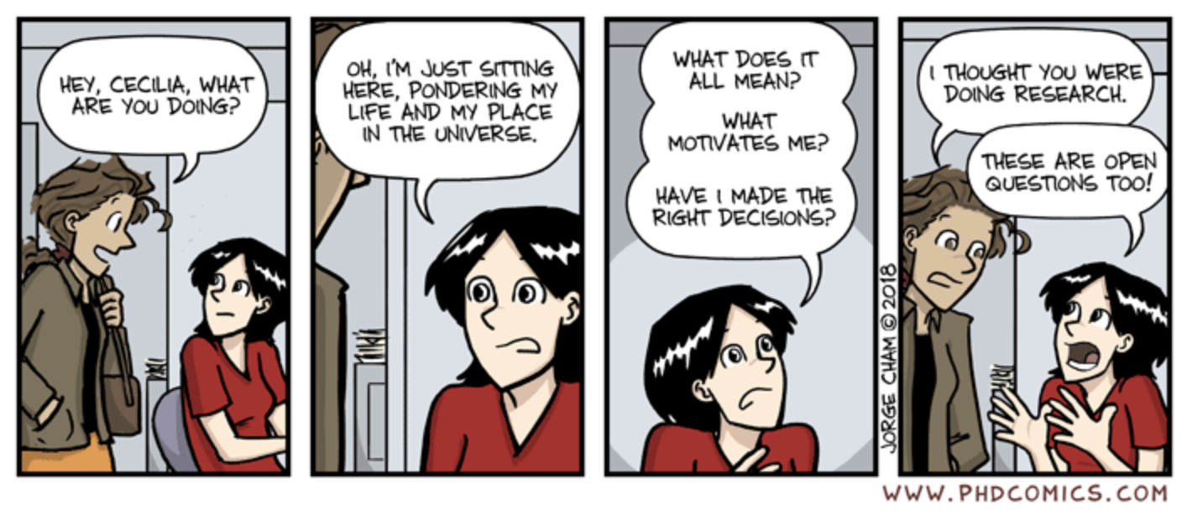
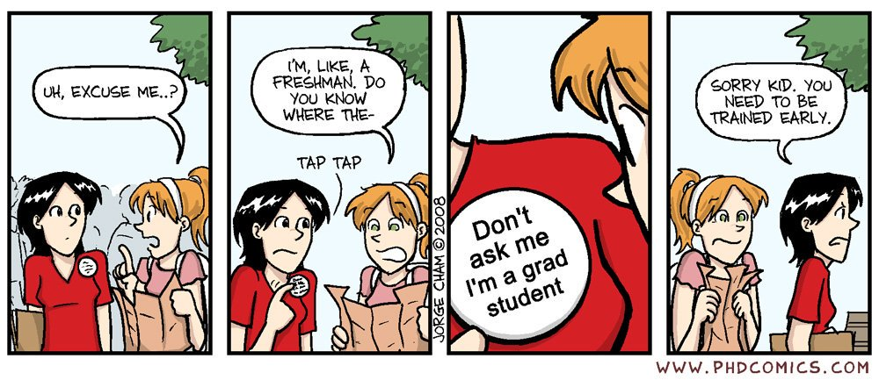
The DS Board
September 30th, 2020 Andri Spilker, DS Board

Slide 3
The DS Board
Doctoral education
Chalmers
Wage negotiation
Our goal improve terms for doctoral students by:
representing in boards and committees at Chalmers
identifying, preventing and eliminating structural problems;
becoming a hub for doctoral students.
DS Board
Develop-ment projects
PhDs working condition
Yearly activities

Slide 4
Student?
Employee?
You are both

Slide 5
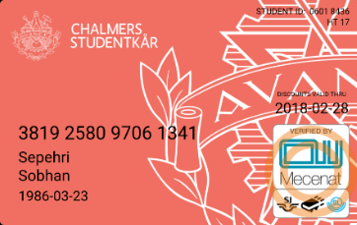
Student
Employee
Chalmers Studentkår
Appraisal Talks
Contract of employment
Collective labor agreement
Individual Study Plan (ISP)
Right to supervision

Slide 6
You as an employee

Slide 7
As an employee of Chalmers you are entitled to:
Before finishing employment
Become a member of A-Kassa and Trade Union to receive unemployment benefits
at least one year membership before becoming unemployed
Appraisal Talks
Contract of employment
Collective labor agreement
Read about the details in the collective labor agreement: https://www.dokt.chs.chalmers.se/media/Collective-agreement_Finalt-uppdaterat-kollektivavtal-130930.pdf

Slide 8
Parental leave
Vacation
Sick leave

Slide 9
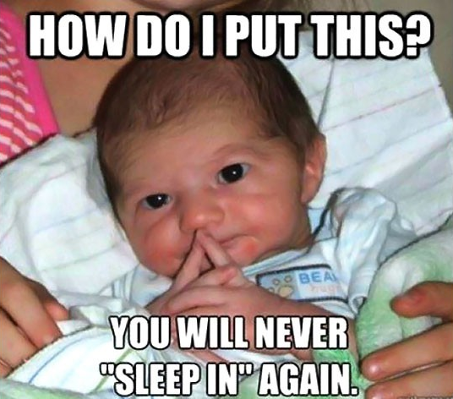
Parental leave
Inform 2 months prior to the expected date of leave
Entitlement to contractextension
Vabba = Caring for sick child
https://www.forsakringskassan.se/
Notes:
Apply for parental leave as far in advance as possible.
You can be on parental leave full time until your child is 1.5 years old
and part time (max. 25 %) until your child is 8 years old.
Extension of employment by the corresponding length of time
Inform your manager when you are at home looking after your child when he or she is ill (known as VAB – and the verb vabba – in Swedish).
www.forsakringskassan.se

Slide 10
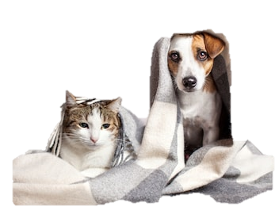
Sick leave
Day 1 report to manager - karensdag
>7 Days – doctors certificate to LRS
80% salary (Day 2-15)
more than 14 days - Collective agreement, intranet
https://intranet.chalmers.se/en/working-at-chalmers/working-environment-health/sick-leave/

Slide 11
Vacation
You have 28 days a year!
Take your vacation!!
It’s important to rest and restore
Don’t save your vacation to the end of your phd!
https://intranet.chalmers.se/en/working-at-chalmers/working-environment-health/sick-leave/

Slide 12
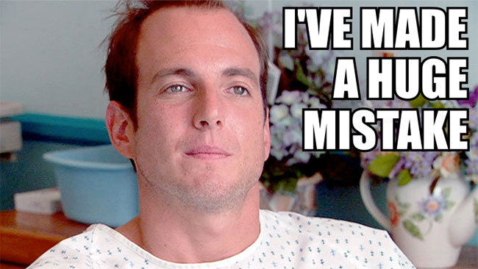
Stay healthy
Use Occupational Health Service: Pe3
Use Doctor.se
You have one hour a week off work for wellness
Wellness services :
Two small free gyms at Chalmers
Free yoga, jiujitsu
Wellness group
Alcohol abuse
Smoking Cessation Support
Use wellness subsidy, 2000kr Benify @ Chalmers plus
Also 2000 kr for prescribed medicine

Slide 13
You as a student

Slide 14
Supervisor
PhD defense
Licentiate degree
PhD student
1st day
Examiner
Director of Studies
P – Plan U – Update S – Sign
Y – Yearly
Line manager
Individual study plan (ISP)
Read about the details in the rules of procedure:
https://www.dokt.chs.chalmers.se/media/Rules-of-Procedure-Doctoral-Programmes-ENG-slutversion-2015-03-03-1.pdf

Slide 15
What do you need to do? And Where can you seek help?
(Be informed and seek support in time)
Member of student union
Member of the trade union
Local PhD councils
DoktrandSektion (DS)
Unions
DOMB (Doktrandsombudsman)
(DS)
1901-01-01

Slide 16
Enjoy student life!

Slide 17
”All members should thrive and develop during their time at Chalmers”

Slide 19
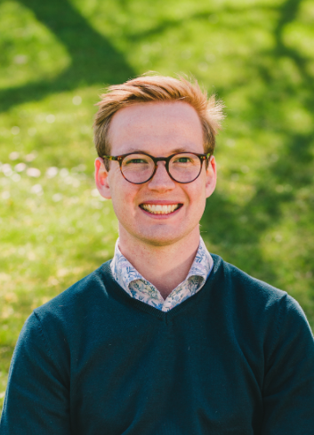
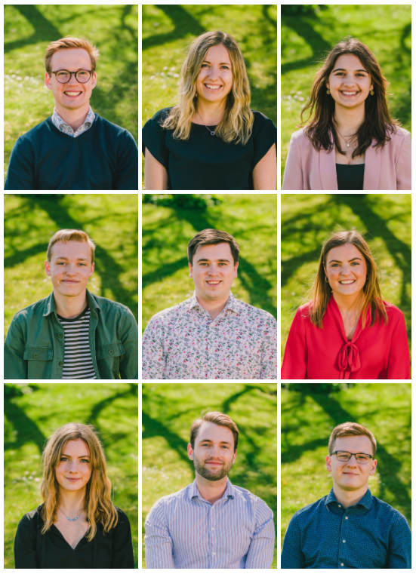
Contact us if you have any questions!
David Welander
President 2020/2021
ko@chalmersstudentkar.se
https://chalmersstudentkar.se/

Slide 21
Chalmers Student Union Sport Association
Swimming
Biking
Golf
Rowing
Padel
Volleyball
Ultimate Frisbee
Soccer
Badminton
Practice
-
Meet
-
Recharge
150 SEK/year
(additional fee for certain sports)
Membership
cis-chalmers.se

Slide 22
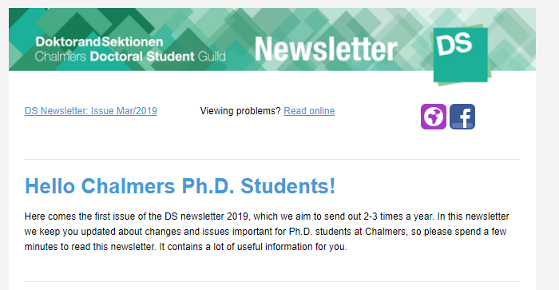
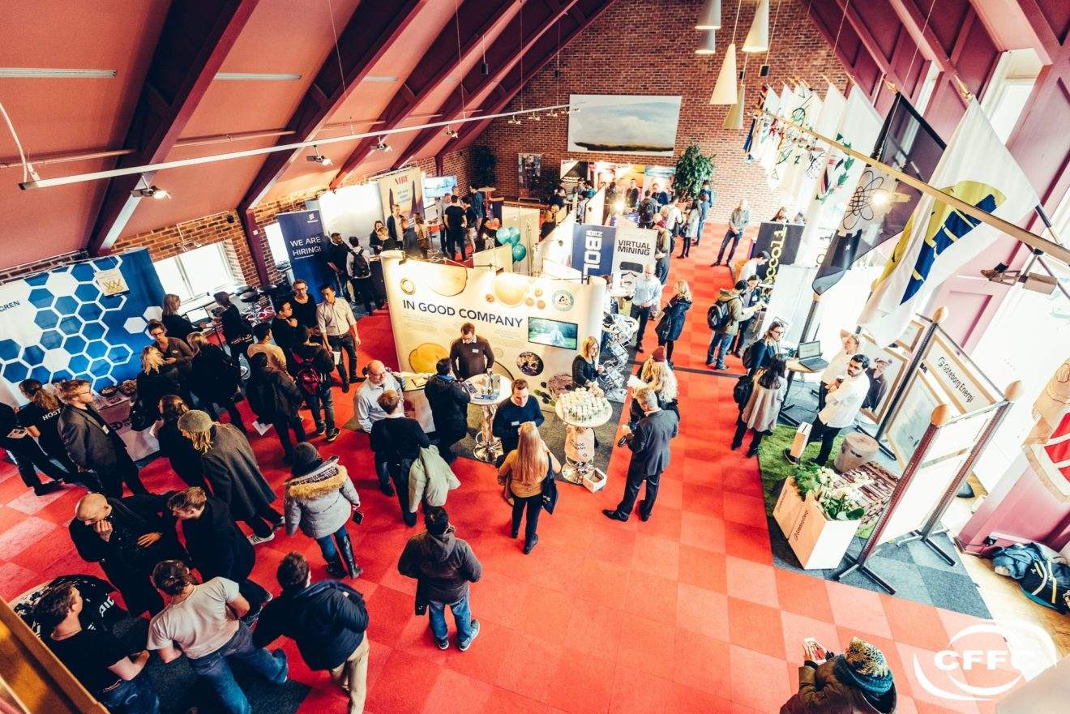
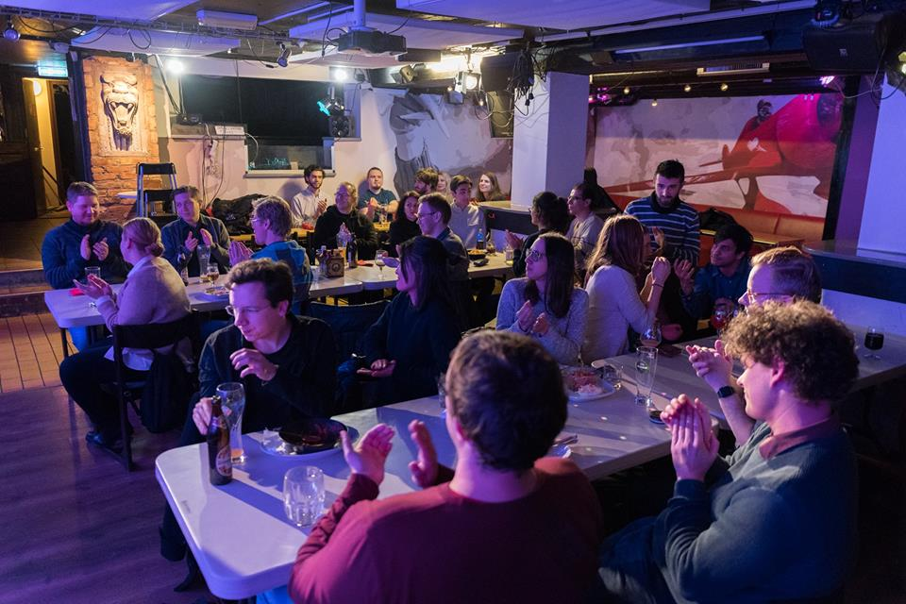
Activities by the DS Board
Supervisor of the year (soon!)
Newsletter (quarterly)
Election Committee
Introduction Day
CHARM Alumni Event
Social Activities
Also,
Representation of PhD students at CHARM
Wage negotiations….
Notes:
Do you want to know what happens inside your computer??

Slide 23
URL of the website – bookmark it NOW!
https://www.dokt.chs.chalmers.se/
Notes:
Okay now lets take out the phone

Slide 24
Useful links
Handbook for doctoral studies
https://student.portal.chalmers.se/doctoralportal/handbook/Pages/default.aspx
DS homepage
www.dokt.chs.chalmers.se
Rules of Procedure: https://www.dokt.chs.chalmers.se/documents/2020/08/rules-of-procedure-doctoral-programmes-eng-new-22-06-2020.pdf/
Collective agreement: https://www.dokt.chs.chalmers.se/media/Collective-agreement_Finalt-uppdaterat-kollektivavtal-130930.pdf
Intranet:
https://intranet.chalmers.se/
Harrassment
http://www.chalmers.se/insidan/EN/employment/harassment

Slide 25
What if something goes wrong?
And you need help in:
identifying issues,
discussing potential solutions
support in meetings with the supervisor or department.
Solutions:
Talk to your manager ☺☺
Arbetsmiljöet – Working Environment group ☺ arbetsmiljo.stodet@chalmers.se
DOMB 😐 (doktorandsombudsman)

Slide 26
Moyra McDill B.Eng., M.Eng., PhD, P.Eng., FCAE
Working in industry – numerical analysis
Carleton University, Ottawa, Canada (now Prof. Em.)
Teaching, research and administration
First woman with Ph.D. in Mechanical Engineering
First woman promoted to Full Professor in Engineering
Dean’s Advisor for Women in Engineering
Assoc. Chair for Undergraduate Studies (student advocacy)
Faculty Committee on Admissions and Studies (appeals)
University Academic Integrity Committee (faculty)
Notes:
I’d like to begin by introducing myself because in some departments there has been considerable surprise about both my background and my employment status. First I am an experienced academic with the usual number of letters after my name and a few more besides with a background in advocacy and appeals at the student level and ethics at the faculty level and value-added experience as an independent commissioner on a regulatory judicial tribunal (I am the vertically challenged commissioner brown pants day) as well as work and research experience in Sweden…. and second I am not an employee of Chalmers. In fact I am proud to be employed by the student union and contracted by DS. Carl is my boss. I can tell you that being employed by a group of bright, interesting, dynamic 30-somethings is pretty cool. I realize that when I show up in your departments that it is not good news and I appreciate that BUT my being contracted by DS makes me relevant not as some of your colleagues seem to feel and occasionally express, irrelevant.
Licensing of all nuclear-related activities
Health, safety, security and the environment
Beng 8 Meng 7 PhD 7 Peng 7 FCAE 14 - Alfapet Score of 43
Last point: As you read in my report
My Communications with doctoral students and all case files are confidential
I can advise, suggest or encourage but in any situation actions are student led.
I am Neutral with respect to the rules but act solely in the interests of the student.
I Support or represents doctoral students in difficult conversations and situations.
I can mediates, intervene or act on behalf of a student when requested to do so by the student.

Slide 27
Notes:
I will come back to Supervision-related and workplace related and non-standard end
ROP (needs work) …. Anders asked me where I saw concerns with the ROP. 15 pages, pretty much every page has been marked up. It is nearly impossible of course to consider every possible thing to consider but let me point out a couple right now:

Slide 28
DOMB Contact
Moyra McDill
Email : domb@dokt.chs.chalmers.se
Drop-in : Wednesdays 12:00 - 13:00
student union building (Kårhuset) @ Emilia
Call : +46 707 839825
Tu, Wed, Thur. 12 – 13
Messages can be left
Zoom, Teams, Skype and similar meetings are available on request.

Slide 29
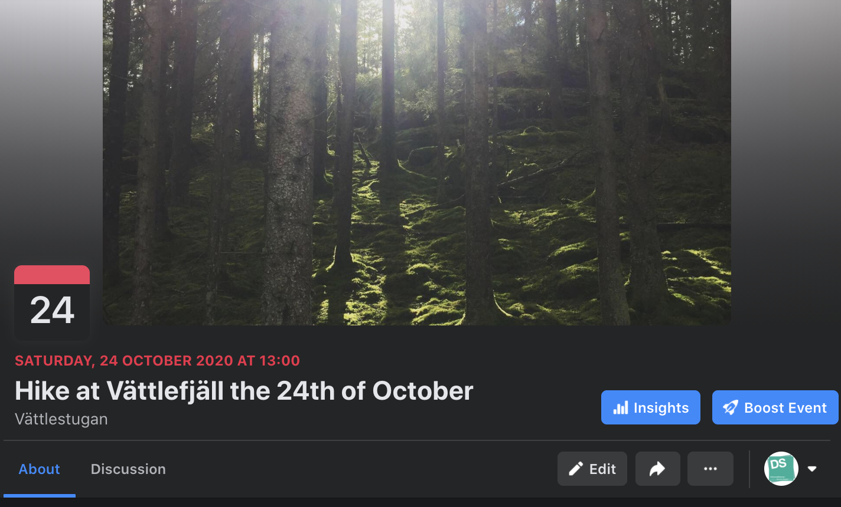
Hope you found something useful!
Next DS social event coming up is a hike!
Would be fun to see some of you there!

