Slide 1
Introduction Day
INFO FROM the Chalmers Physics PHD Council (CPPC)

Slide 2
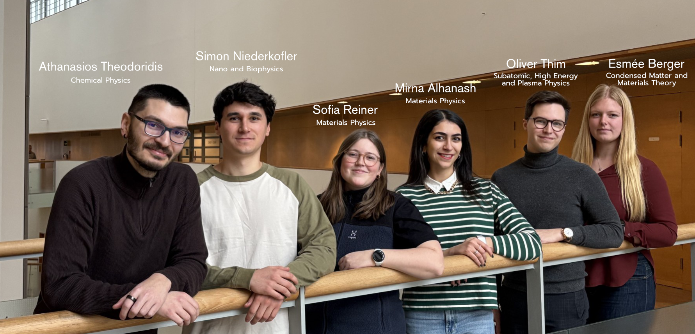
CPPC – Chalmers Physics PhD student council
Promote common interests of graduate students
Inform graduate students of their rights and responsibilities
Facilitate good relations among graduate students, as well as between graduate students and the Department of Physics.
Email any issues or questions to
phdcouncil.f@chalmers.se or contact your representative directly.
More information on our homepage: www.dokt.chs.chalmers.se/physics-phd-council

Slide 3
ONGOING work
Represent Physics students in various committees (PhD Council meetings, Electronic Study Plan, Department Advisory Council, Gender Equality Council)
Discussions about teaching distribution
Compilation of list of courses taken by PhD students in CPPC webpage (Through DS webpage)
Distribution of important information to Physics students
Introduction day activities
Buddy system

Slide 4
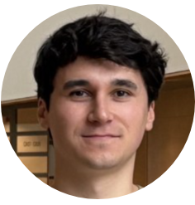
Buddy system
Simon
Your Buddy can
show you around
be available for questions
go through the checklist with you

Slide 5
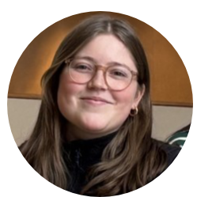
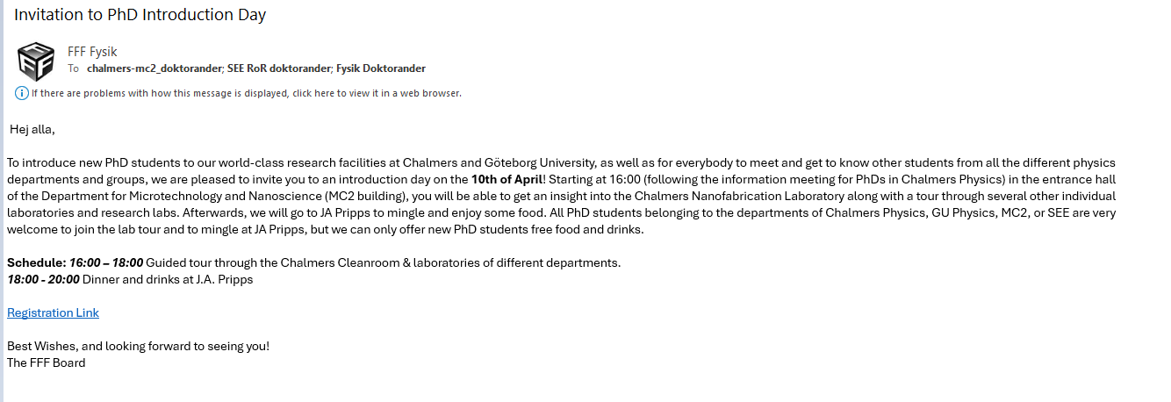
FFF
FFF
Physics GU
Physics Chalmers
MC2
SEE
The purpose of Föreningen för Forskarstuderande i Fysik (FFF) is to
Care for the graduate students' common interests.
Act as a forum for discussing common interests.
Work for good unity between graduate students.
Sofia
Examples of activities:
Career seminars
Gatherings – BBQs
Social events for scientific interaction
Visit to a company or a research center

Slide 6
Who are we?
Chalmers Doctoral Student Guild (DS)
Student Union body at Chalmers
Represent PhD students in Chalmers boards and committees
Identify, prevent and eliminate structural problems
Hub for connections between PhDs
Follow us! @ChalmersDoktorandsektionen
www.dokt.chs.chalmers.se

Slide 7
Supporting instances at chalmers
The doctoral students’ representative, or DOMB (Doktorandombudsmannen)
PE3 – Occupational health service partner (offers: occupational physician, occupational health nurse, physiotherapist/ergonomist, behavioural scientist/psychologist and work environment engineer.)
Safe at Chalmers – Reporting of harassment
Further information is available at www.dokt.chs.chalmers.se/support-for-phd-students

Slide 8
DOMB – Doctoral student ombudsman
The doctoral students’ representative, or DOMB, helps individual PhD students with problems that may arise during their research or employment.
The DOMB is employed directly by the DS board and is therefore independent, unbound and neutral.
Strict DOMB-student confidentiality is provided.
What issues?
Work environment + Supervision
Work related illness, rehabilitation, return to work
Ethics + plagiarism
Harrassment (gender, parental leave) + Bullying + Racism
Rules of procedure, collective agreement, labour law, etc.
?
Further information is available at www.dokt.chs.chalmers.se/support-for-phd-students

Slide 9
Contact the domb
You can contact the DOMB by email, phone or drop-in. The office is in the Student Union Building, floor 3, room 2.318
E-mail address: domb@chalmersstudentkar.se, Phone: 031-772 39 29
For Chalmers support, this webpage can also be a helpful resource:
https://www.chalmers.se/om-chalmers/organisation-och-styrning/trygg-pa-chalmers/
?
Pia Nykänen
Further information is available at www.dokt.chs.chalmers.se/support-for-phd-students

Slide 10
pe3
Chalmers occupational health service partner
Doctors, psychologists, nurses, ergonomists
One preventive conversation sessions (1st one within a week) without manager involvement
Help with:
Work related illness
Rehabilitation
Mental health
Ergonomics
Further information is available at https://intranet.chalmers.se/en/working-at-chalmers/employee/health-ergonomics/occupational-health-service/ (Search for PE3 at Chalmers Intranet)

Slide 11
General tips:
Keep track of your time spent on teaching and check that it is the same as reported by Lena Falk
Check and register the courses on time
Remember your student/employee rights and benefits (ask us if you have any question)
Attend the General Assembly (in December)
Available facilities:
Ping-pong table on floor 3 at Kemivägen 9 (MC2 building) New booking rules!
Sauna also on floor 3 at Kemivägen 9 (MC2 building)
Take care of yourself and others ☺

Slide 12
CPPC Facilities tour
10th of April at 16.00 @MC2 cleanroom entrance
Get acquainted with your fellow PhDs and Buddies
Lab tours
After work organized by FFF

Slide 13
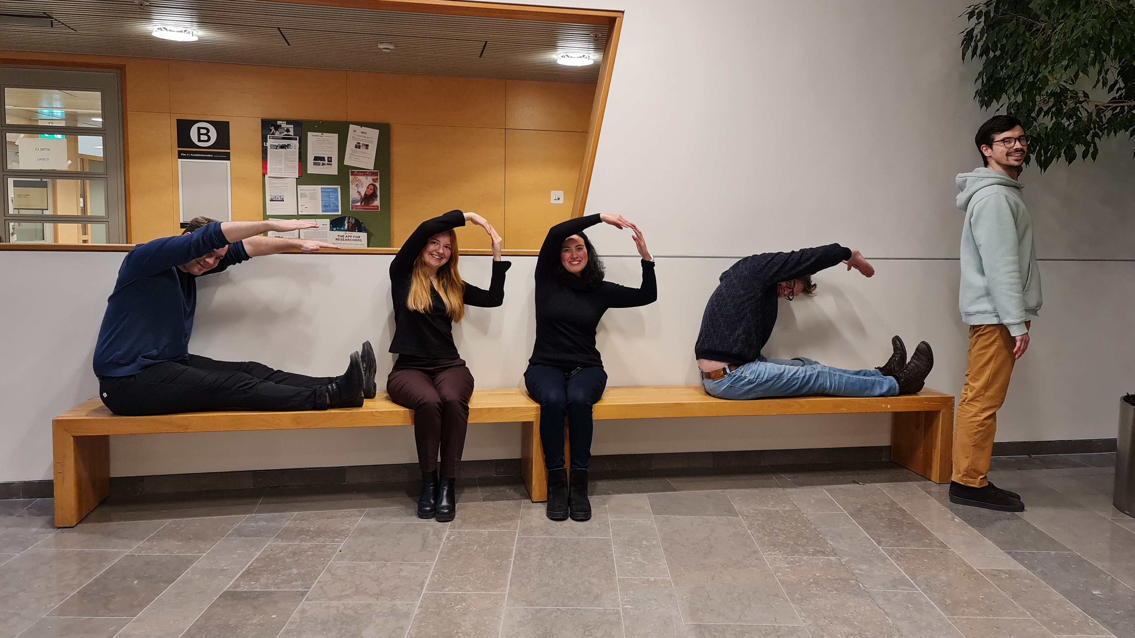
Thank you for your attention
Don’t hesitate to contact us if you have any questions regarding your graduate studies!
phdcouncil.f@chalmers.se
C P P C !

