Slide 1
LRS on Travel meal benefits

Slide 2
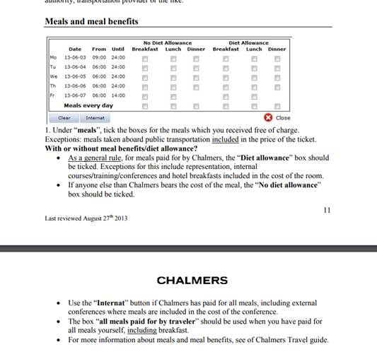
General information on Primula on meals and meal benefits
Did you pay? If not:
Was it free on public transport? (eg plane meal, part of ticket price).
Was it free breakfast (part of hotel price).
Was it free as part of something that Chalmers paid? (eg conference dinner if Chalmers paid for the conference).
Was it free from someone else?

Slide 3
General information on Primula on meals and meal benefits
Did you pay? NO TICK If not:
Was it free on public transport? (eg plane meal, part of ticket price). NO TICK
Was it free breakfast (part of hotel price). TICK
Was it free as part of something that Chalmers paid? (eg conference dinner if Chalmers paid for the conference). TICK with diet allowance.
Was it free from someone else? TICK

Slide 4
Question to LRS
Lets say that I travel to an external (non-chalmers organized) conference abroad:
Day 1: I travel by plane, and I get served the airplane breakfast (included in the price). Then I land and wait for a few hours, and have lunch at the airport which I pay. Then I take another plane which serves dinner (included in the price) and I finally arrive to my hotel.
Day 2: The hotel has breakfast included in the price. Later I get free lunch from the conference which I am attending. Lastly I pay the dinner for day 2 myself. Assuming that Chalmers paid for both the flight, the hotel and the conference, how would I fill the table below for days 1 and 2?

Slide 5
LRS answer
Day 1:
I travel by plane, and I get served the airplane breakfast (included in the price). → Meals on public transportation included in the price doesn’t reduce per diem so no tick for meals here.
Then I land and wait for a few hours, and have lunch at the airport which I pay. → No tick, since you paid for the lunch yourself.
Then I take another plane which serves dinner (included in the price) and I finally arrive to my hotel. → Meals on public transportation included in the price don’t reduce per diem so no tick for meals here.
Day 2:
The hotel has breakfast included in the price. → The breakfast reduces per diem but it’s one of the exceptions for meal benefit so here you should tick in the left column “no meal benefit”.
Later I get free lunch from the conference which I am attending. → If Chalmers has paid a conference fee your should tick the right column for lunch “With meal benefit”
Lastly I pay the dinner for day 2 myself. → No tick

Slide 6
Final By-the-book submission

